Slide 1
Field-Emission mapping measurement on Copper Surface
Y. Higashi, KEK
LCWS12 RF Structure/Technologies WG (webex)
October 26, 2012, Arlington, USA

Slide 2
Outline
Results of high-power tests of single-cell Standing-Wave structures related to surface processing and copper purity
@Effect of near-perfect surface cleaning on high gradient performance
@ Effect of purity of copper on high gradient performance (4N OFC copper, 6N copper treated with HIP, and 7N large grain copper)
Development of Scanning Field Emission Microscope (SFEM)
Search for location of enhanced field emission
@ Grain boundary measurement on the 7N large grain copper
@ Random search for enhanced field emission on the OFHC Class1 copper
Summary
This work is supported by US – Japan Cooperation Program

Slide 3
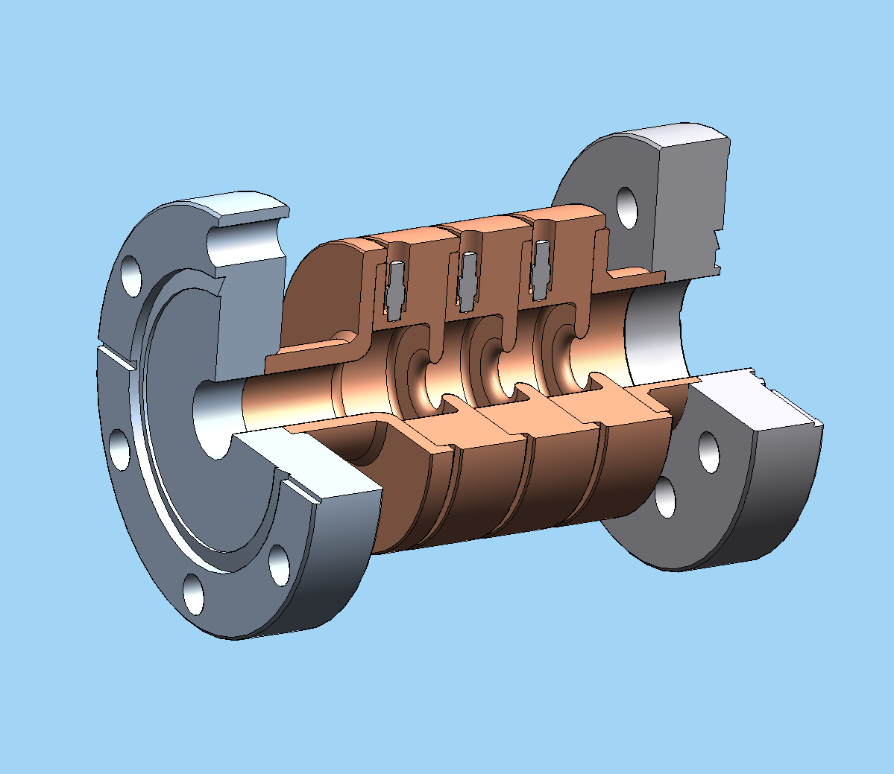
Single-Cell SW Structure for High Gradient Test
High shunt impedance structures, a/λ=0.143
1C-SW-A3.75-T2.6-Cu
Solid Model: David Martin

Slide 4
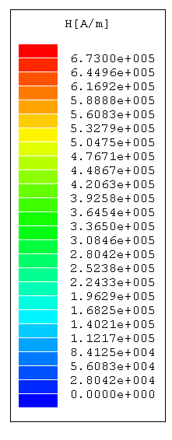
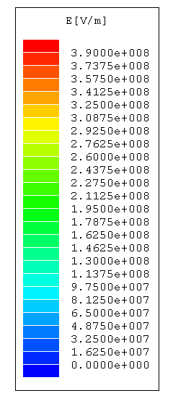
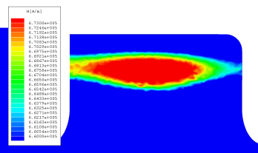
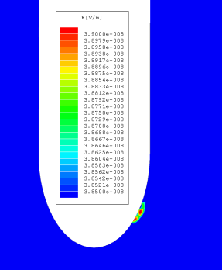
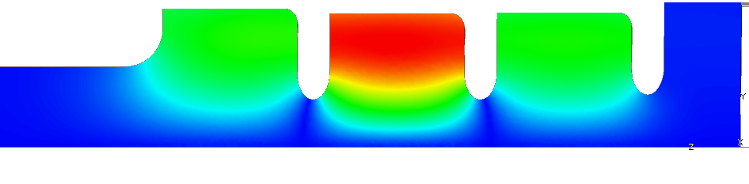
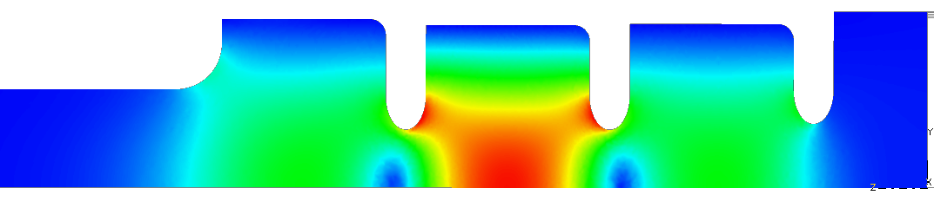
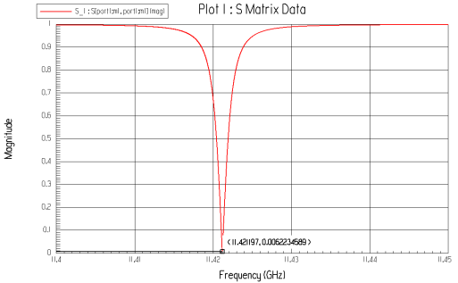
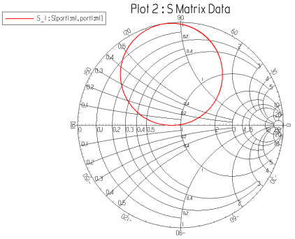
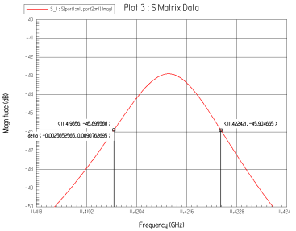
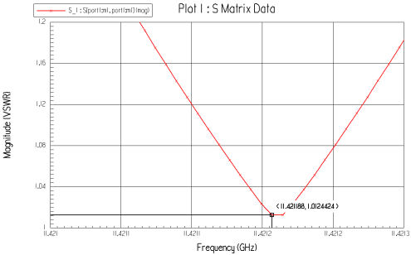
1C-SW-A3.75-T2.6-Cu, a/λ=0.143
10 MW input
Maximum magnetic field 672 kA/m
(SLANS 668.0 kA/m)
Maximum electric field 390 MV/m
(SLANS 398.9 MV/m )
Resonance at 11.4212 GHz
β = 0.988
Under-coupled loaded Q
(SLANS 11.4241 GHz)
(SLANS 1.032356)
Unloaded Q=8,849.8
(SLANS 8,912.5)
V.A. Dolgashev, 25 September 2007

Slide 5
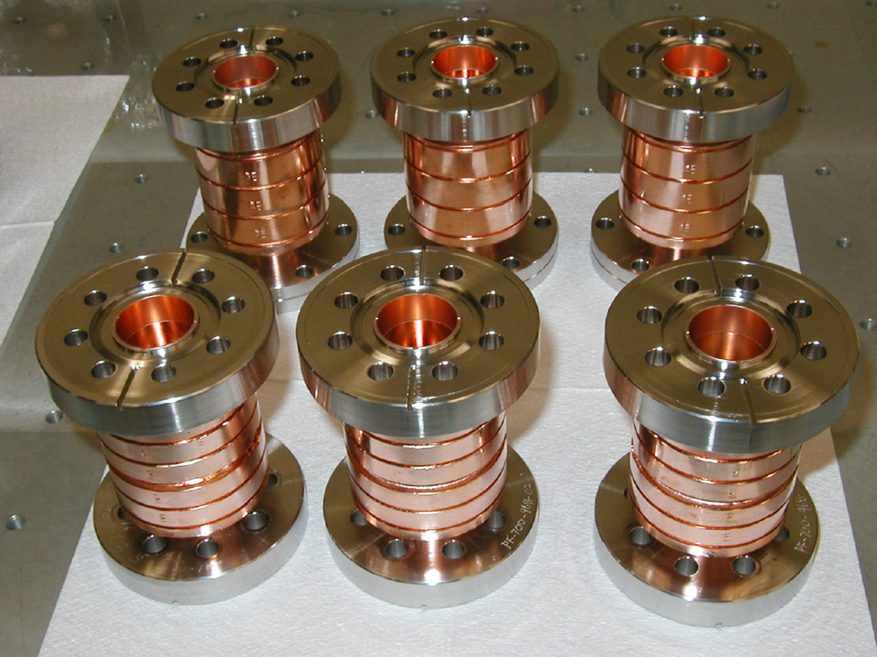

Slide 6
at KEK
1.Bonding
2.Megasonic rinsing with degreaser
3.500degC baking
4.N2 gas purged
5. Goes to SLAC

Slide 8
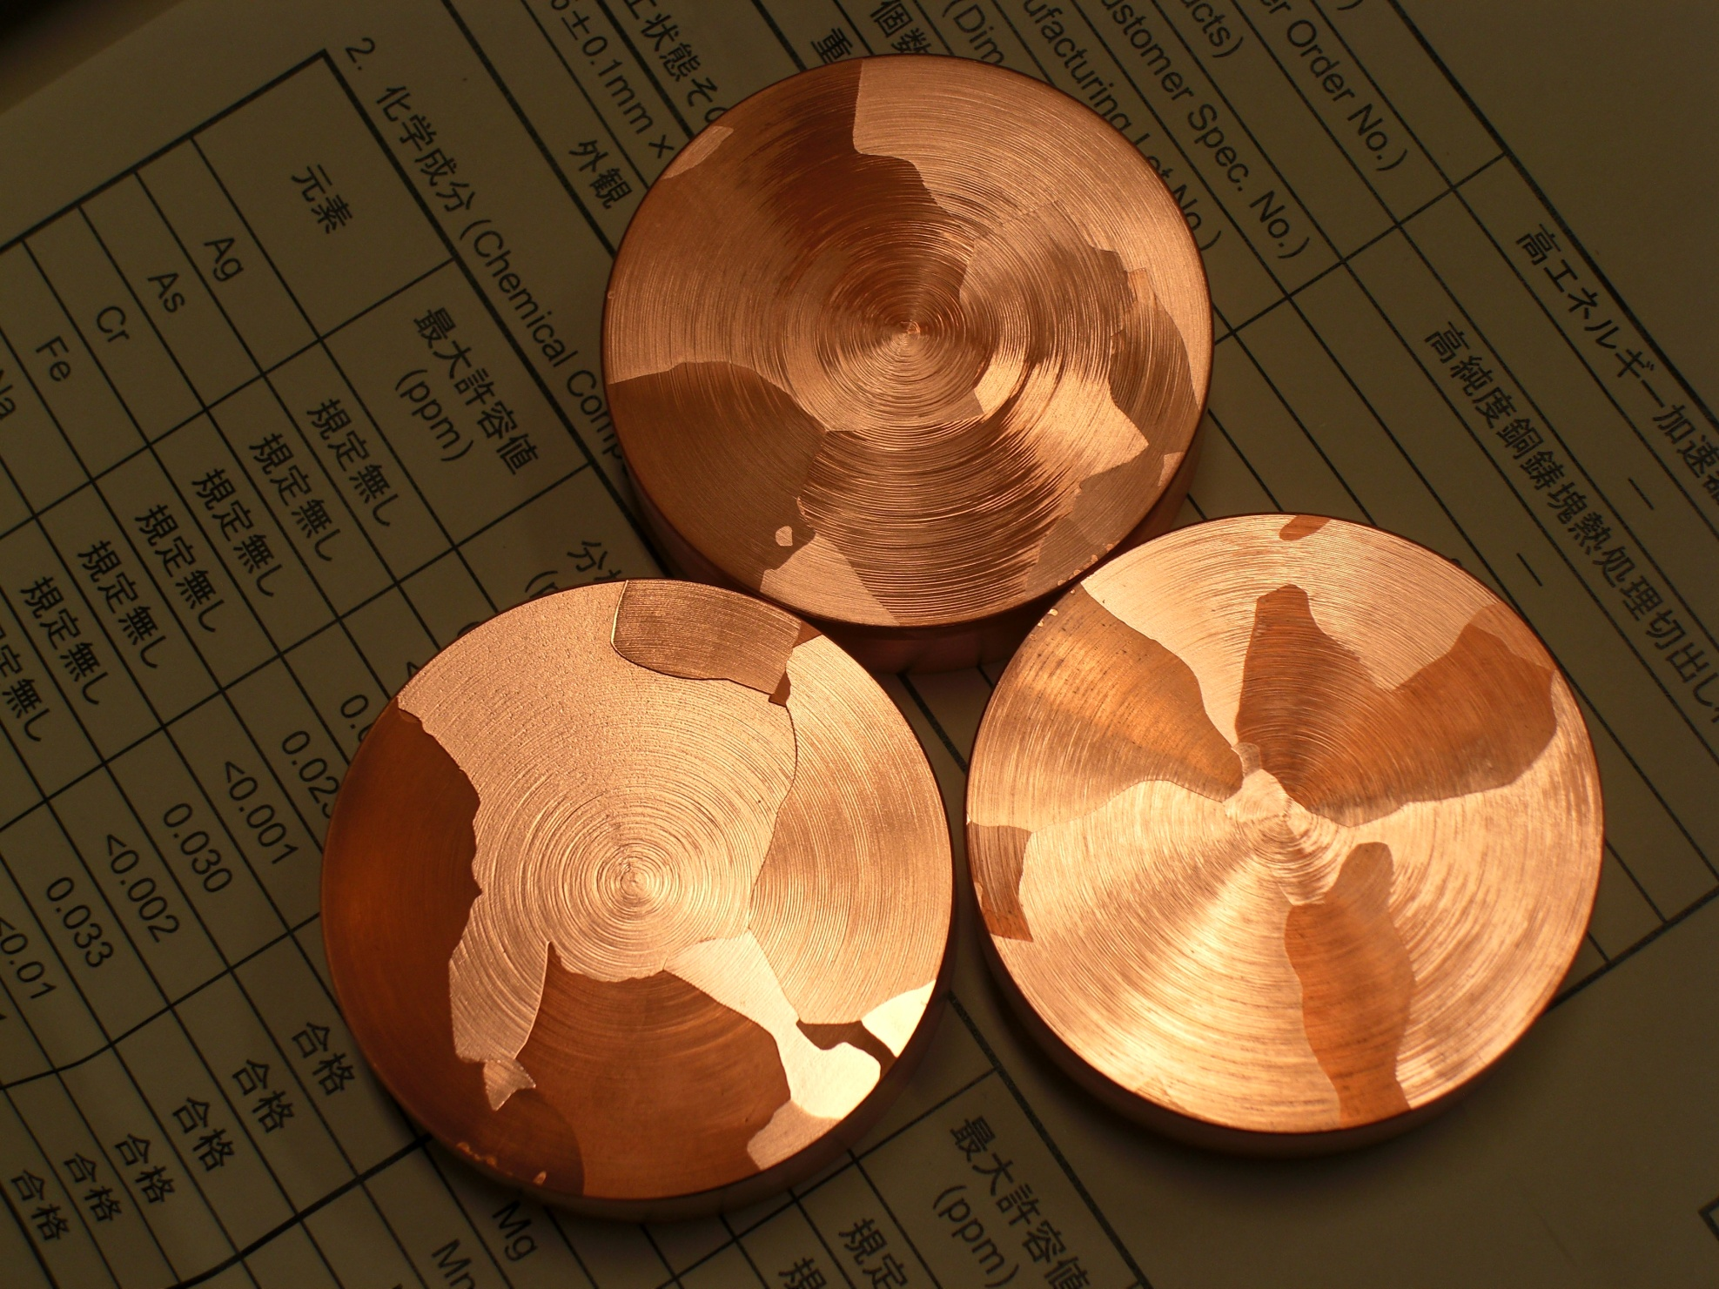
Large Grain 7N copper
Developed by MITSUBISHI MATERIAL Co.

Slide 9
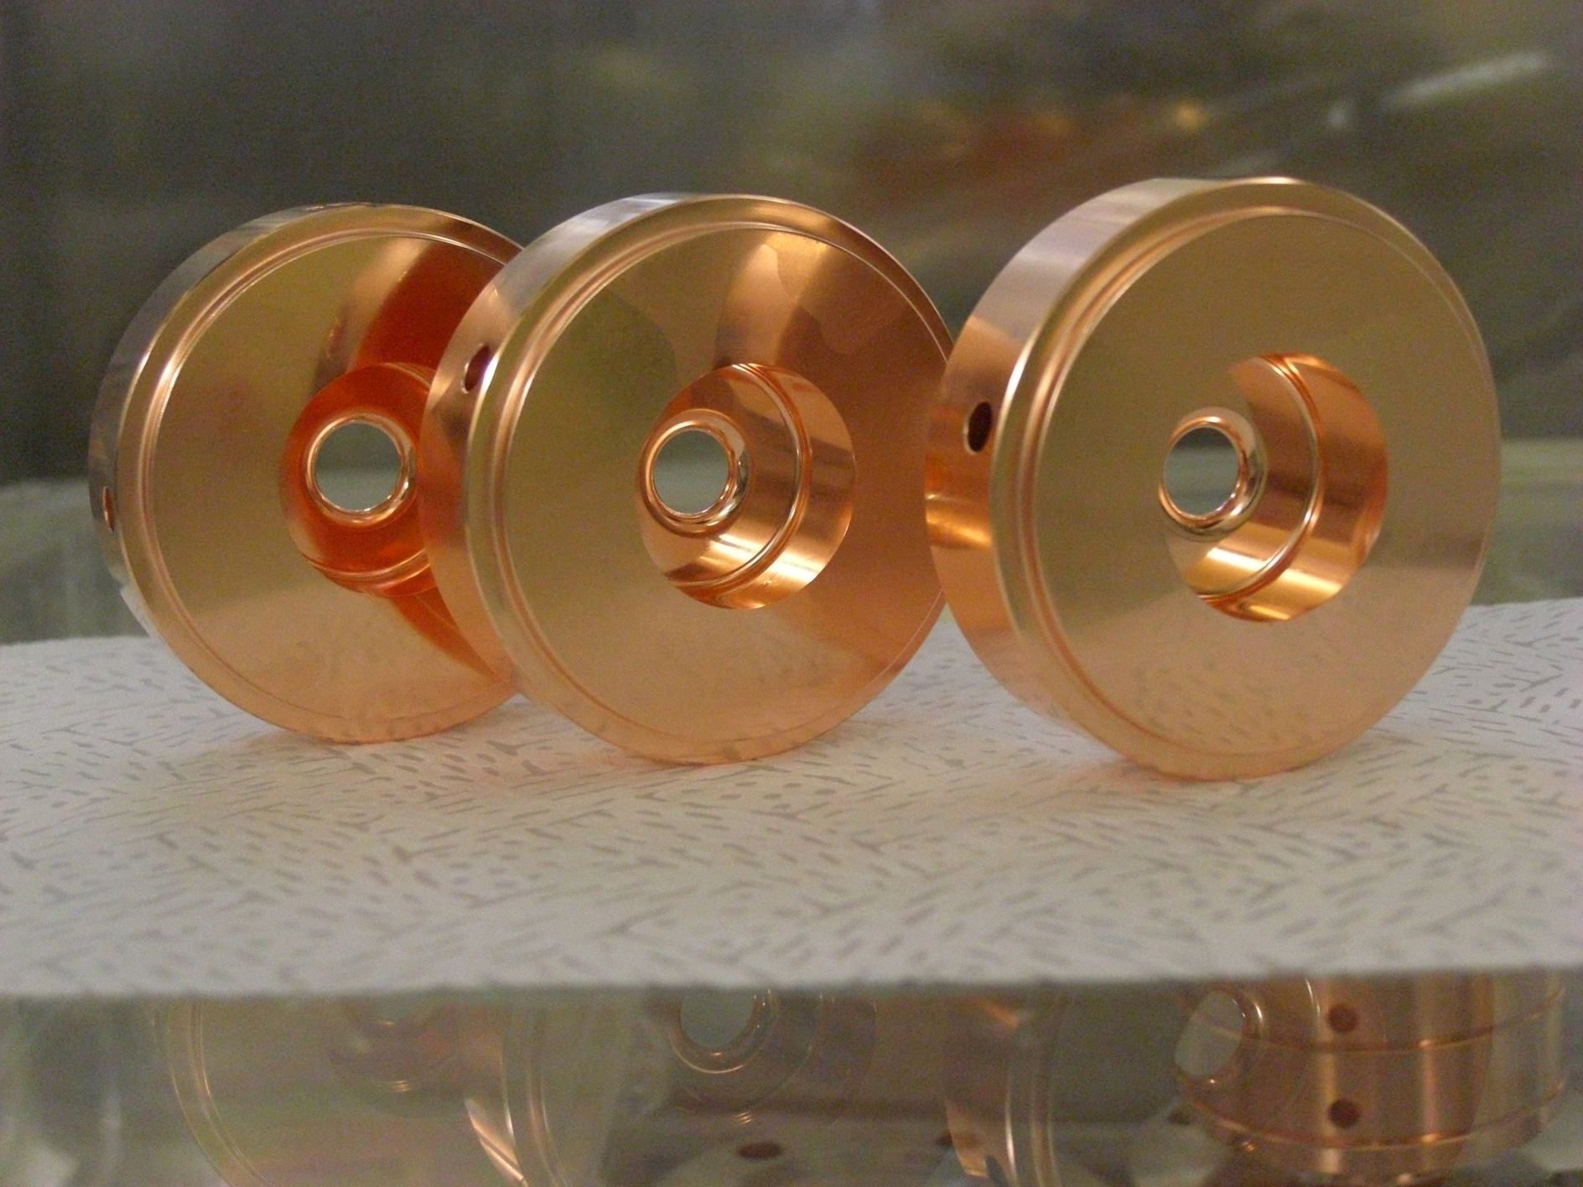
Three cells made by 7N-Large Grain Copper
Development

Slide 10
Breakdown rate vs. gradient for A3.75-T2.6 copper structures, one “standard” OHC, another 7N,
shaped pulse, 200 ns flat part
V.A. Dolgashev, 16 April 2010

Slide 11
Why we don’t see difference in rf breakdown performance of ultra-pure copper?

Slide 12
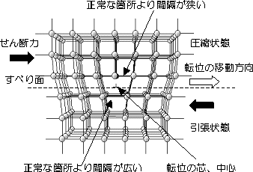
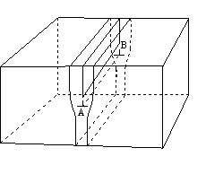
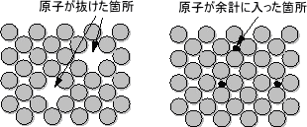
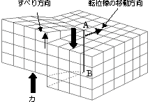
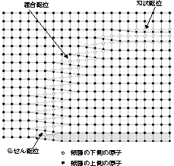
Speculation!!
Crystal defect density almost the same in 4N, 6N, and 7N copper:
Dislocation density seems to be 10^6 ~ 10^8 cm/cm^3
even with annealing.
Distance to dislocation is approximately 1 ~ 10 mm
よく焼きなました金属でさえも転位密度は10⁶～10⁸ cm/cm³ 程度あります。塑性加工した材料では 10¹⁰～10¹² cm/cm³ 程度で， 1cm³当たり地球を２５周するほどの長さの転位線に相当します。また，加工することにより転位は増えることを示しています。
よく焼きなました金属では，転位線の間隔は1～10μm程度であり，3000～5000原子に１個の転位が存在することになります。

Slide 13
Results of High Gradient Tests
Sophisticated fabrication technologies for X-band high gradient accelerating structures successfully developed at KEK with SLAC, INFN and CERN.
We compared breakdown rate for three A3.75-T2.6 copper structures, one OFC copper, 6N copper treated with HIP, and 7N large grain copper. But rf breakdown performance was almost same.
The nearly perfect surface processing affected only processing time. Ultra-clean structures conditioned faster then the normally processed structure.

Slide 14
We want to identify crystal defects by looking at regions with enhanced field emission
We developed Scanning Field Emission Microscope

Slide 15
Scanning Field Emission Microscope Configurations
Tungsten tip: < 1micron radius
Tip movement: linear stage+PIEZO mover
Gap: 1 micron
XY stage stroke +/- 6mm (rough 50mm)
Bias voltage ~240V
Pico-ammeter: ~pA resolution
In-situ gap sensor: 0.01micron resolution
Microscope
Residual Gas Analyzer
Vacuum gauge
Vacuum level : 10⁻⁷Pa
Chamber size: 400 mm diameter and 300 mm height
Residual Gas Analyzer
pA meter
Vacuum gauge
PIEZO
High-Voltage
PMT
W tip
Capacitive sensor
Microscope
Sample
Ceramic plate
XY stage

Slide 16
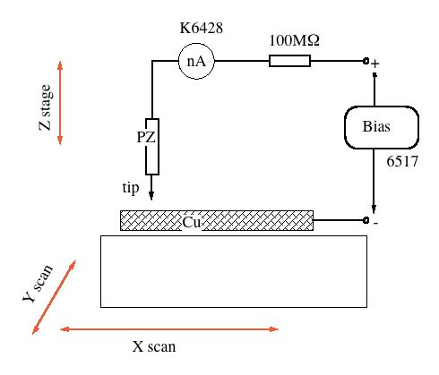
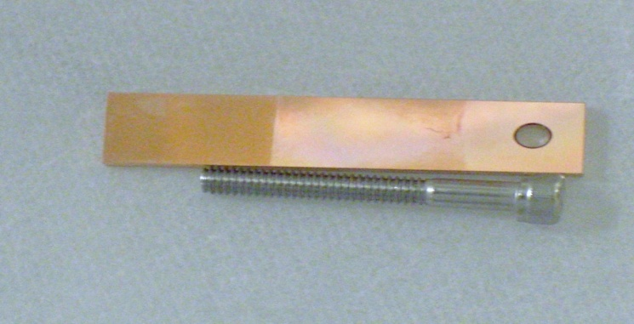
Schematic view of Scanning Field Emission Microscope
Sample
40x10x3mm

Slide 17
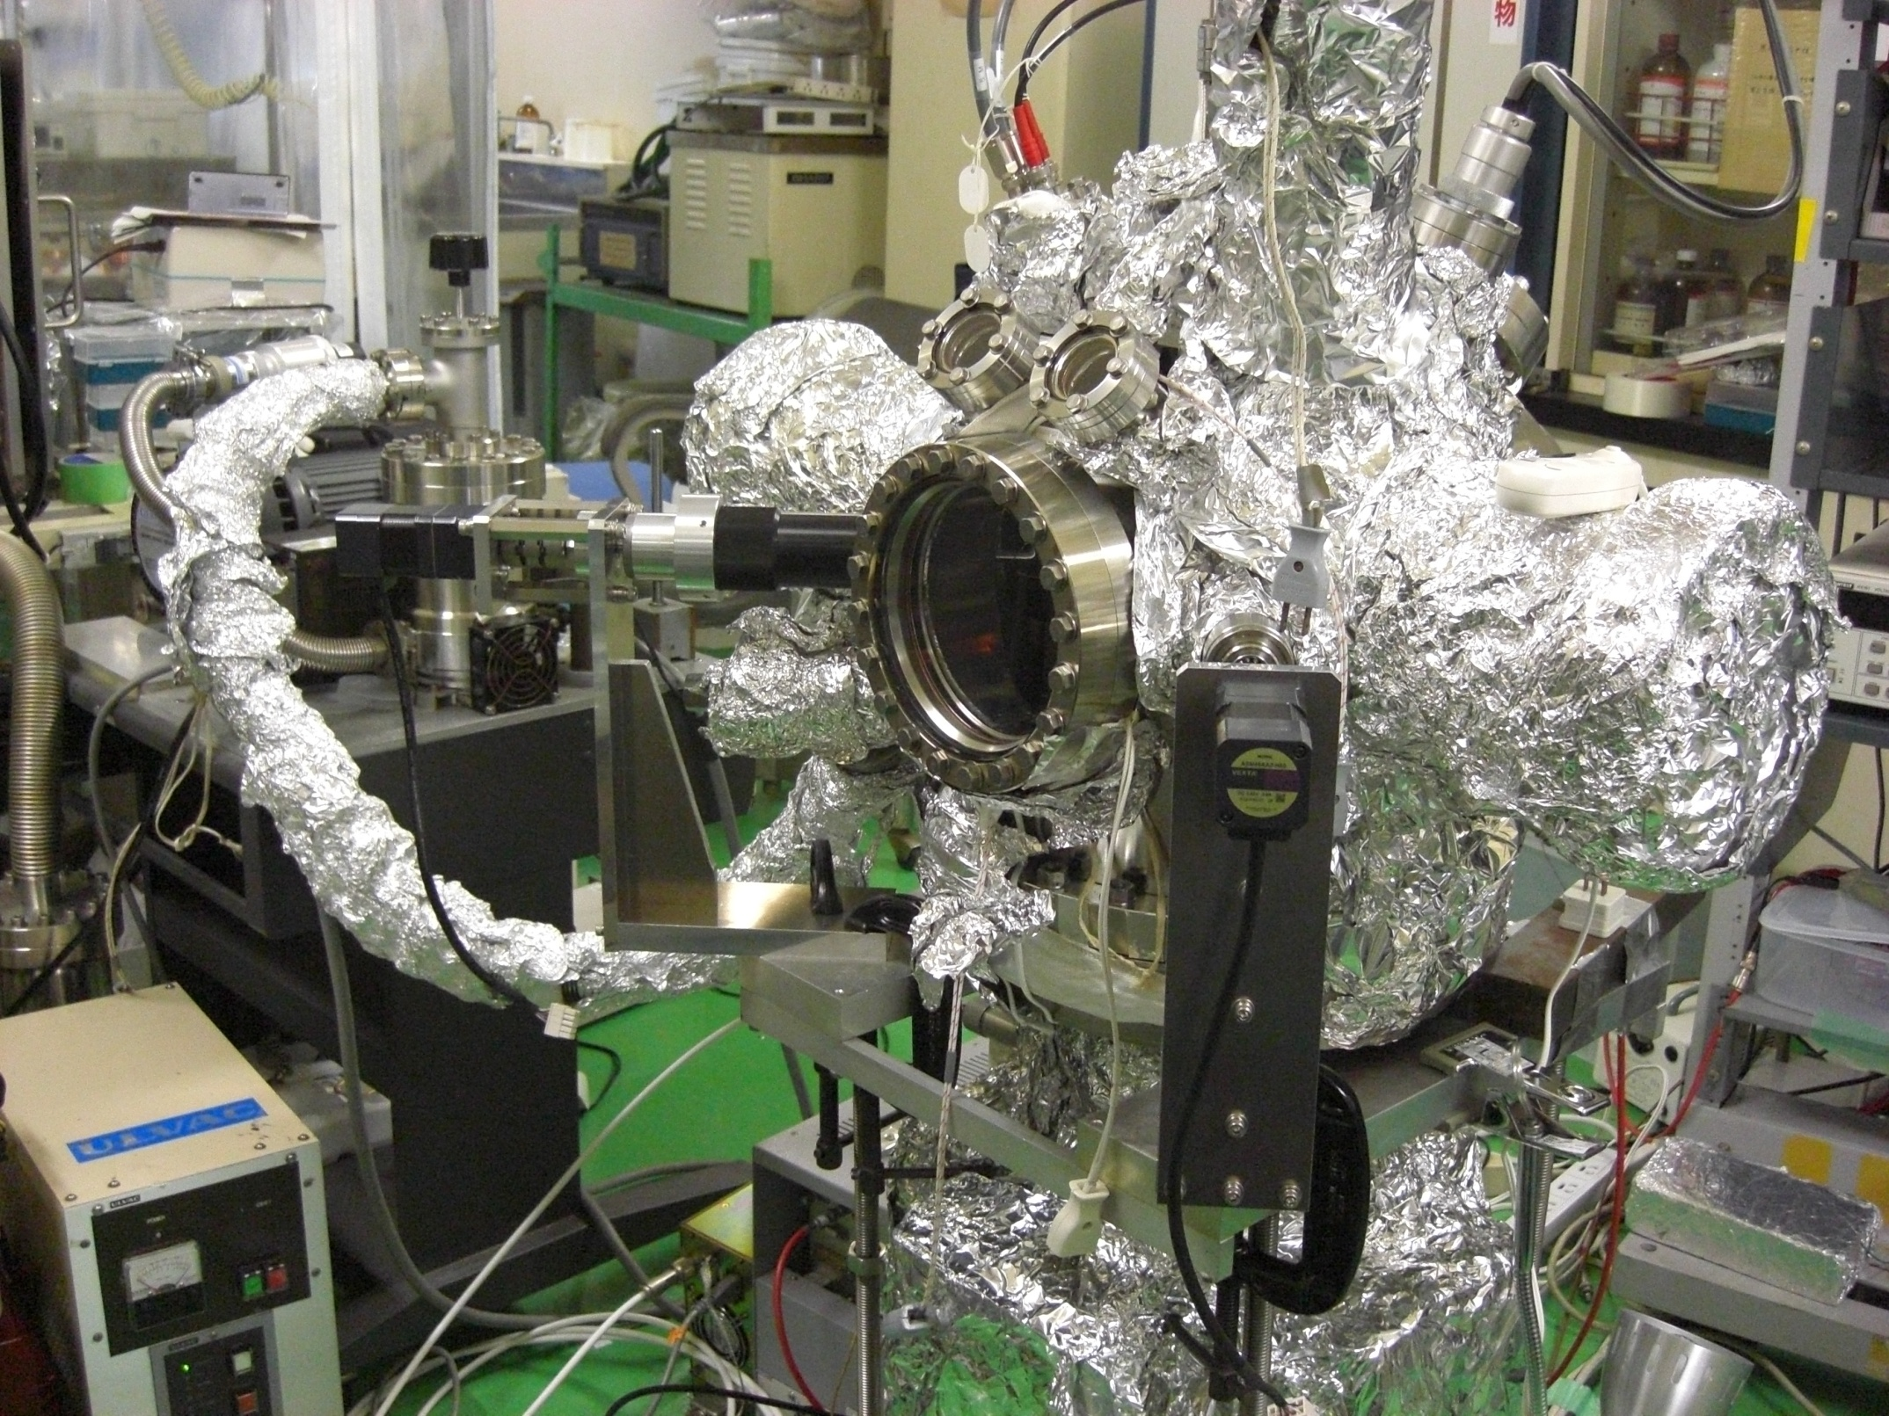
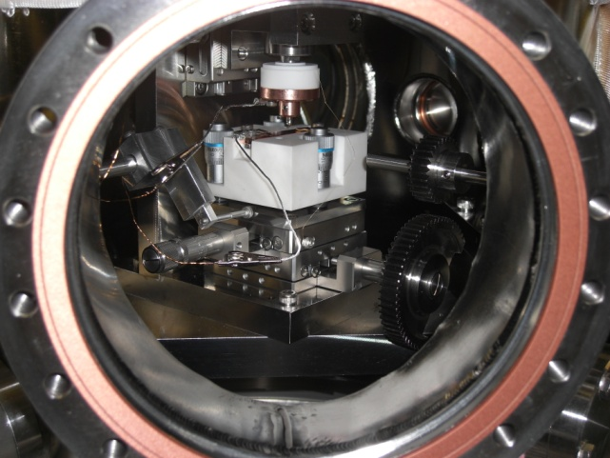
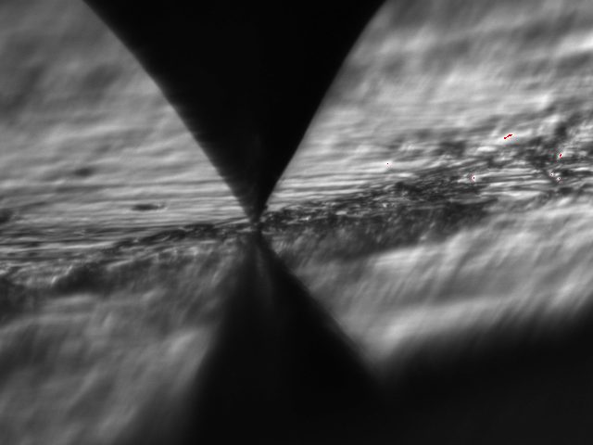
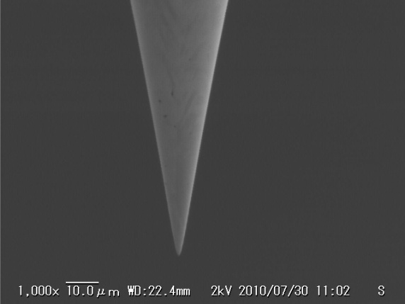
Scanning Field Emission Microscope
Chamber inside
W tip
W tip radius ~1μm
Scanned surface

Slide 18
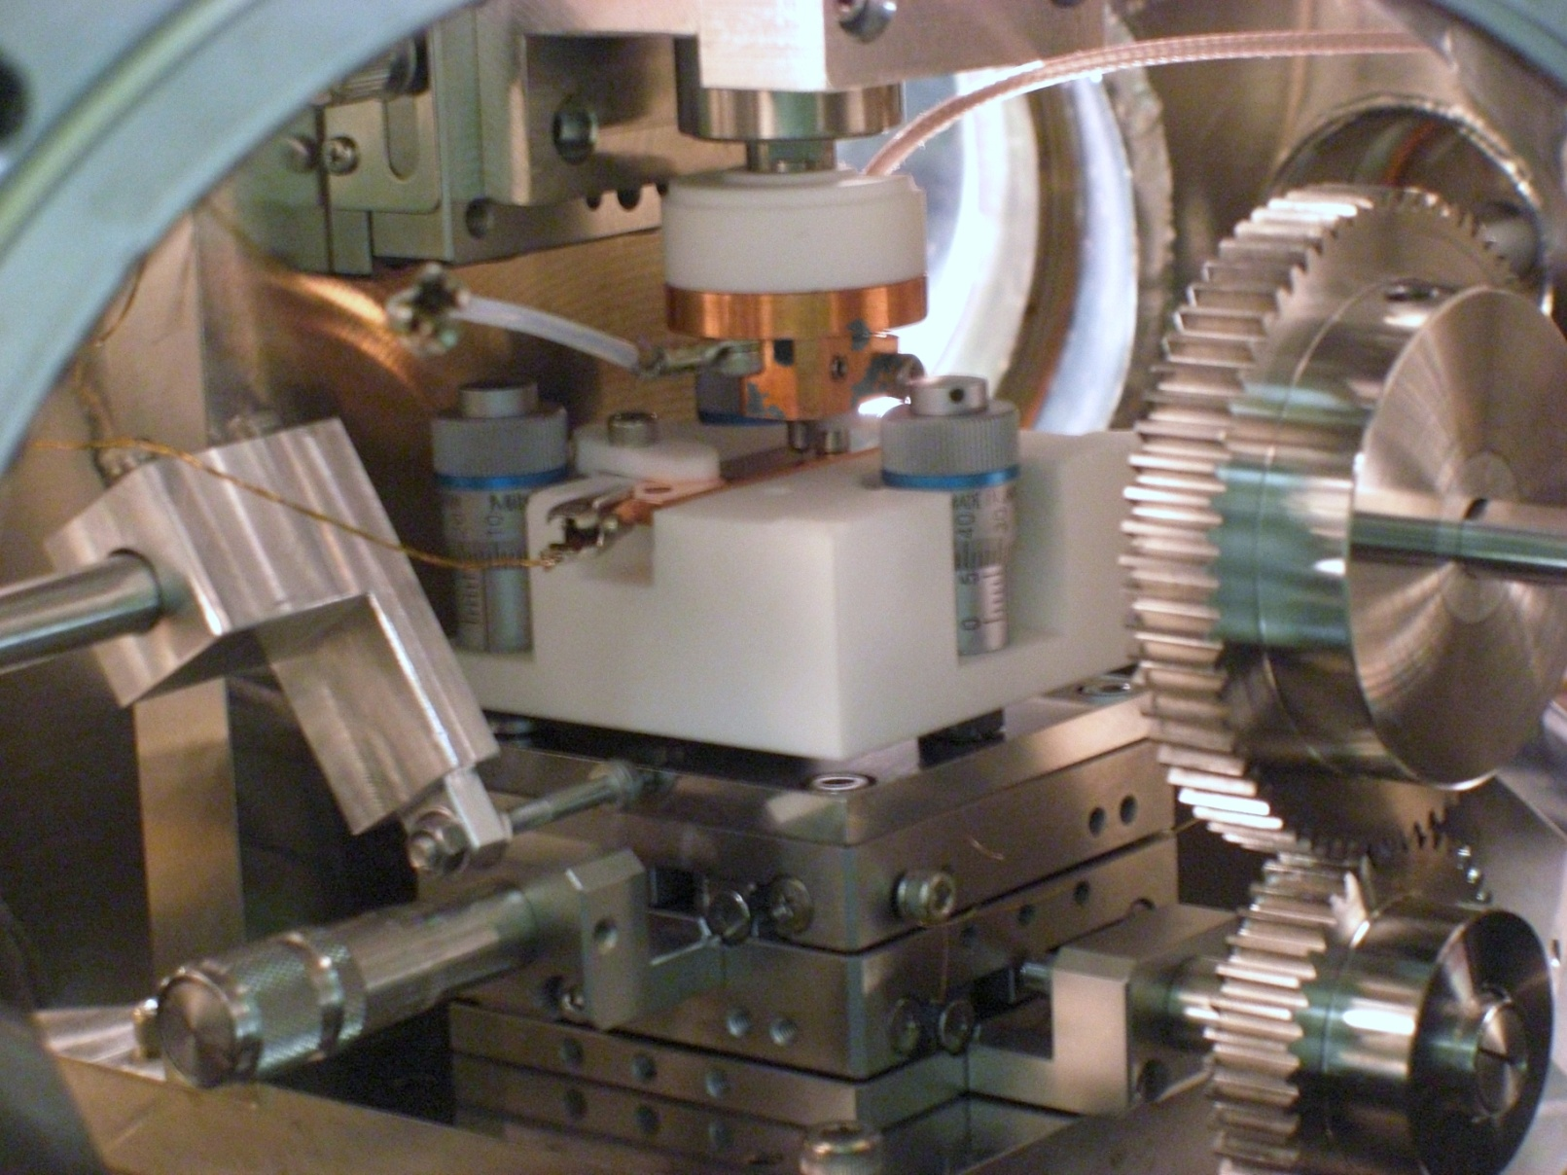
Sample and moving stages
Capacitance gauge
PIEZO actuator
W-Tip
Sample
XY stage

Slide 19
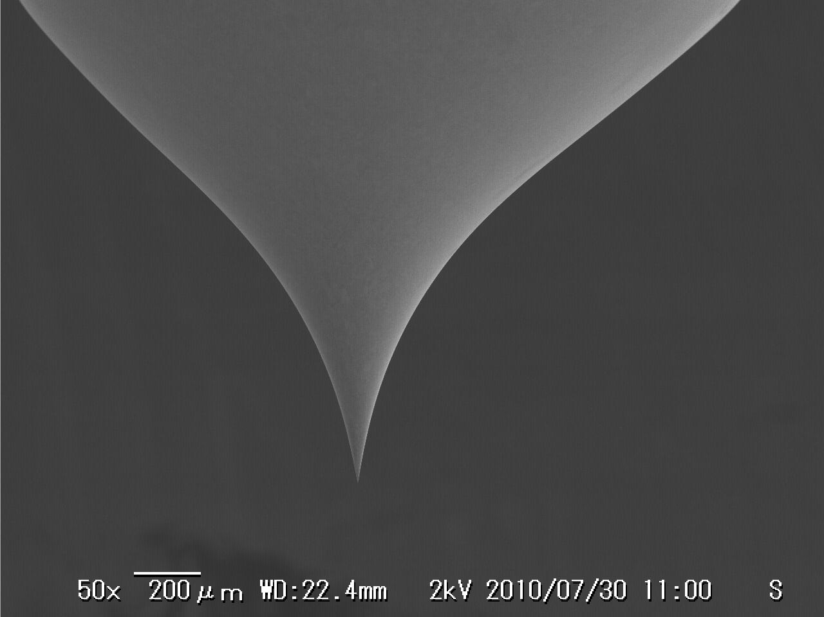
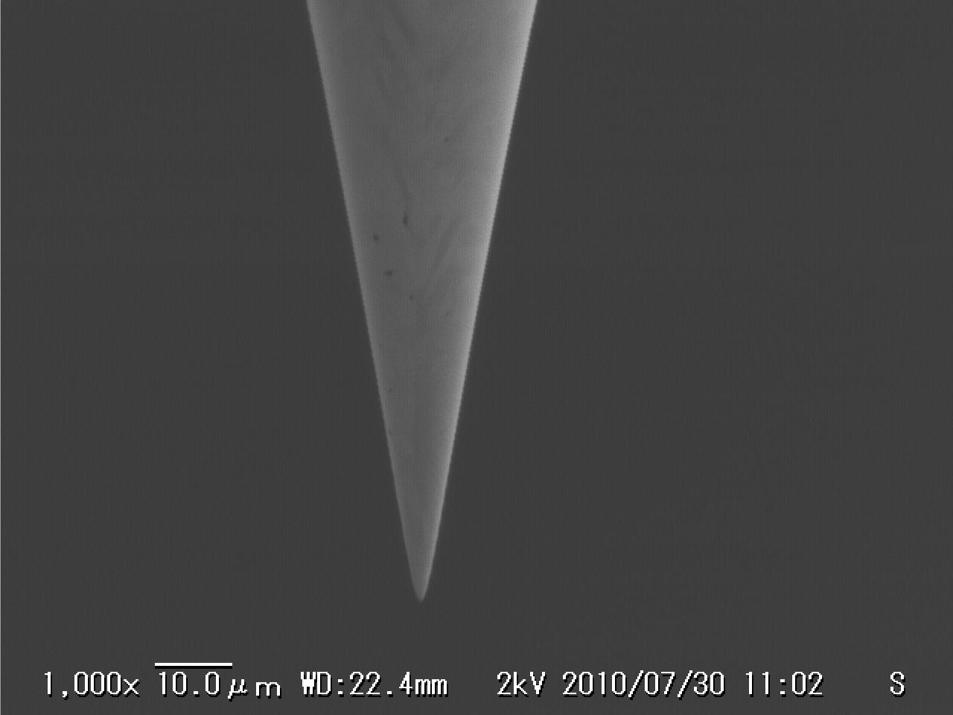
Tungsten Tip made by electro polishing
Polishng conditions
KOH: 1 mol
Voltage: 30 V
Current: 200mA

Slide 20
Field pattern under W-tip
Tip radius (point)
Tip shape (120deg.)
Distance (d)
Maximum field strength <70% of applied bias

Slide 21
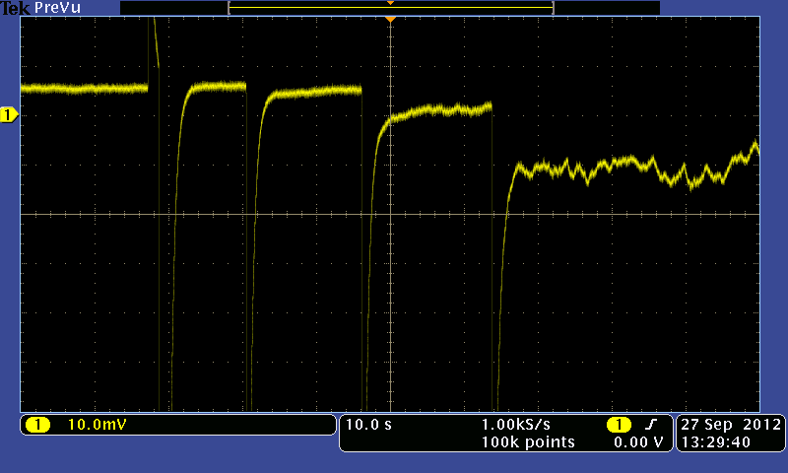
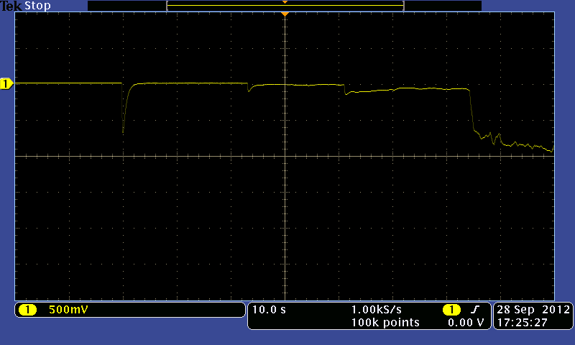
Field Emission Current change due to bias voltage and gap
None 300 350 400 450 (V)
Gap 1μm
Bias voltage change
0.9 0.8 0.7 0.6 (μm))
Bias 450V
Electrode : OFHC Class1
Gap distance change

Slide 22
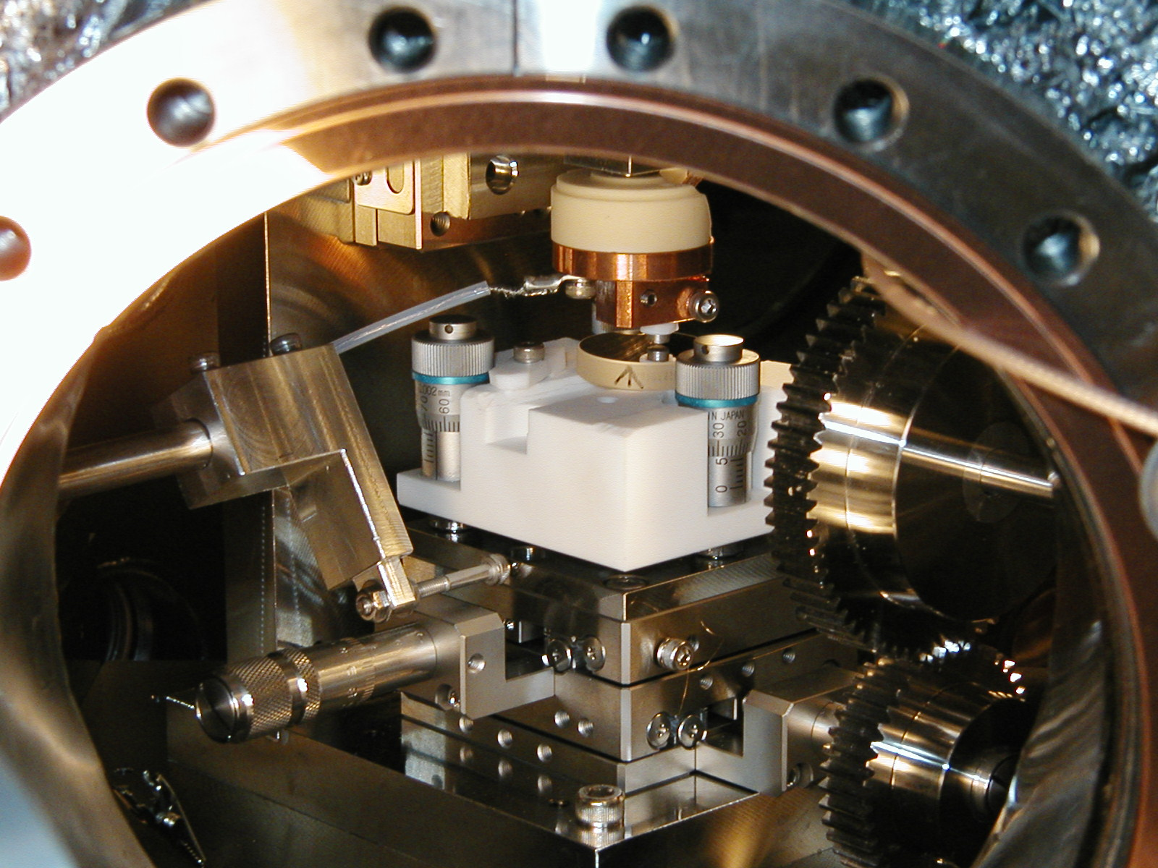
Stability of the table motion
Capacitive sensor
Optical flat surface
1μm
0.1μm
5mm travel

Slide 23
Fowler-Nordheim plots at 35 arbitrary points
Each of the 7 frame includes data for 5 different locations
No observation of field enhancement points
23

Slide 24
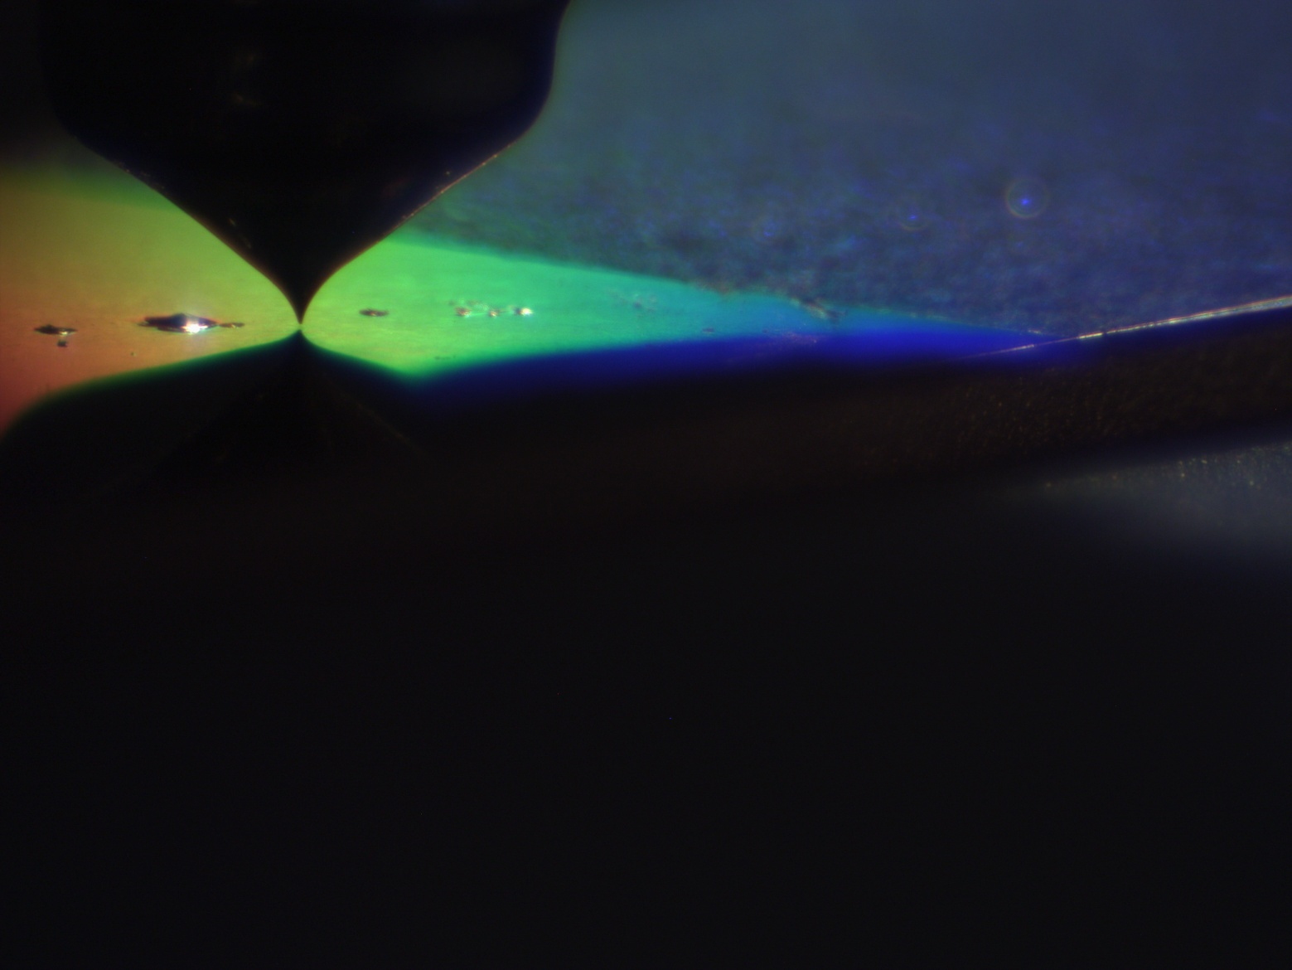
Surface Scan
Etched surface
2mm scan
Mirror surface

Slide 25
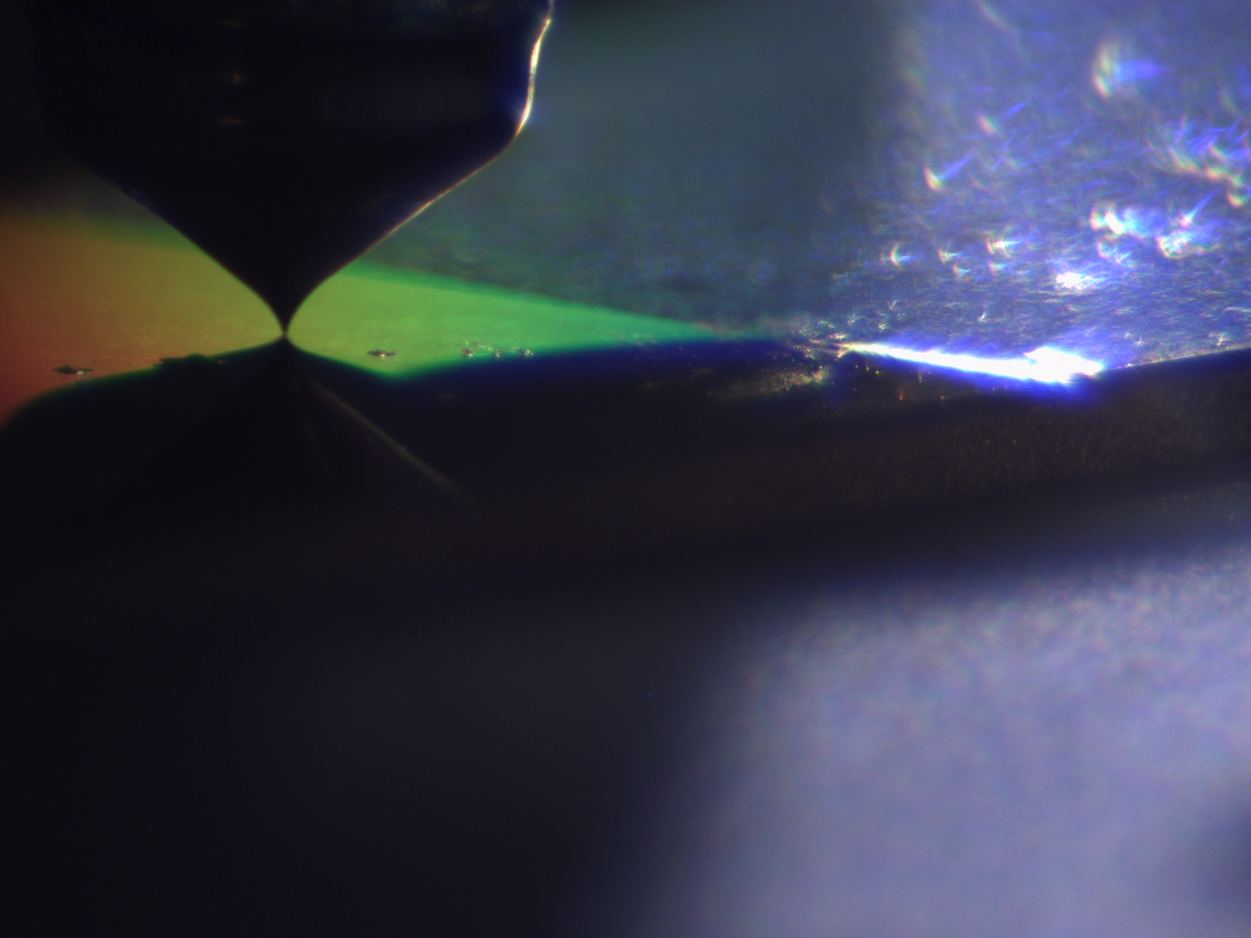
Measured field emission distributions
Mirror surface
Etched surface

Slide 26
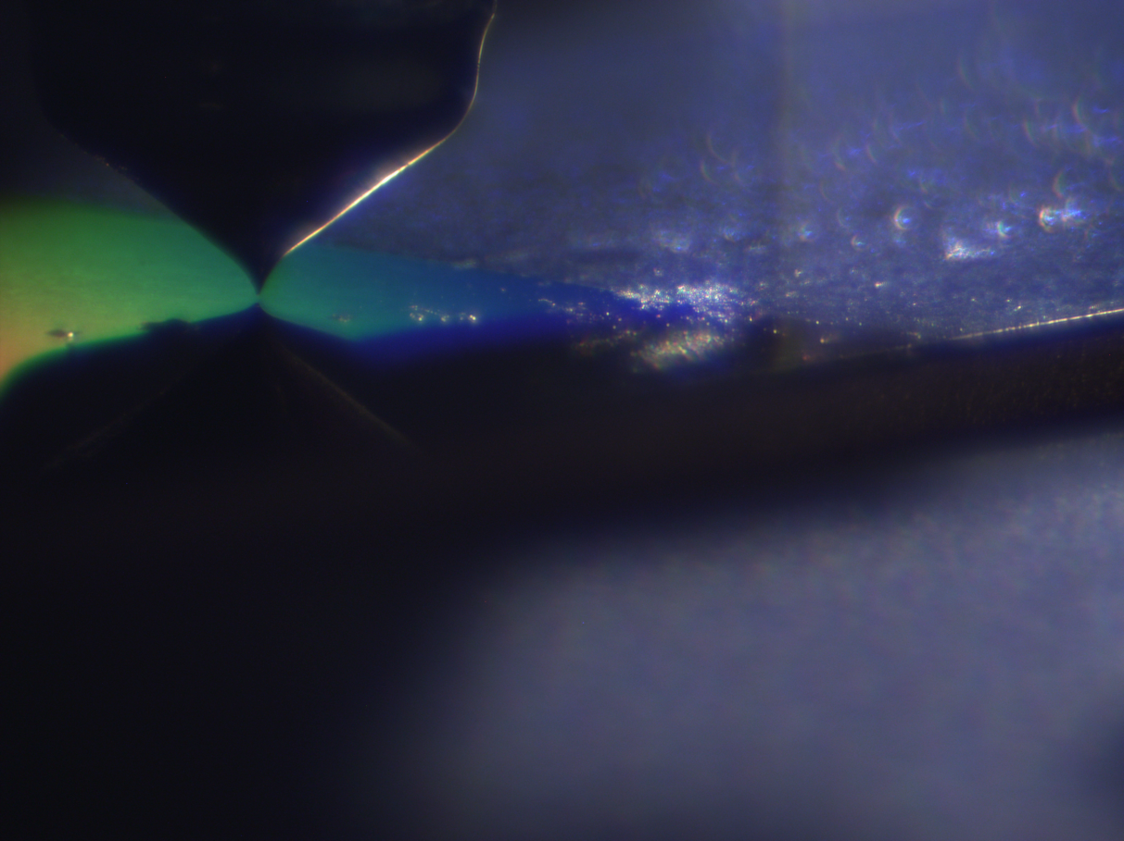

We found no surface damages after scanning on mirror surface
Before scanning
After scanning

Slide 27
Setup commissioning
We found out that pulse motor drive generates
vibration so impossible to get accurate data
Now we move sample manually

Slide 28
Search for Location of Enhanced Field Emission
Scanning grain boundary on the ultra-pure 7N-LG copper
Random scan on the standard purity, OFHC Class1 copper
Sample Surface Preparation
Diamond Turning (20nm rms)
600 deg.C/1 hour heat treatment in vacuum
3 mm chemical etching

Slide 29
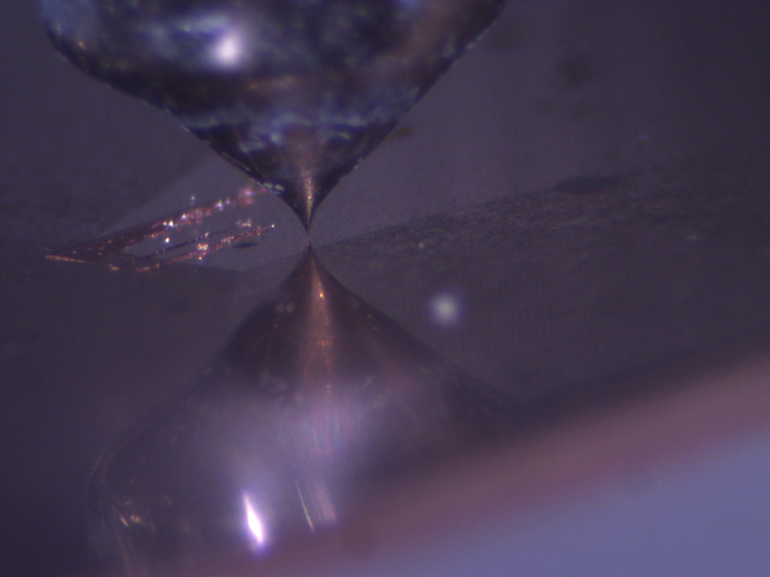
Grain boundary of ultra-pure 7N-LG copper
W Tip
Grain Boundary
Grain Boundary
Scanning Line

Slide 30
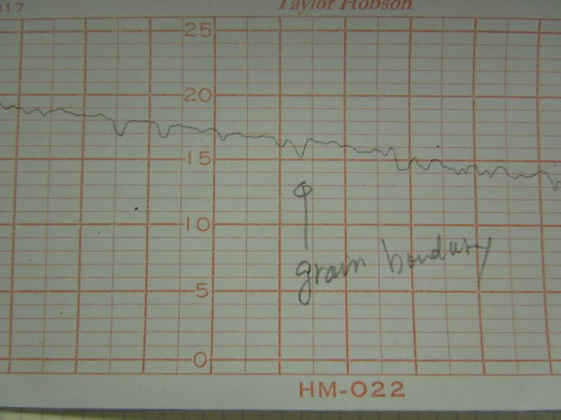
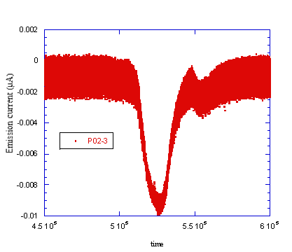

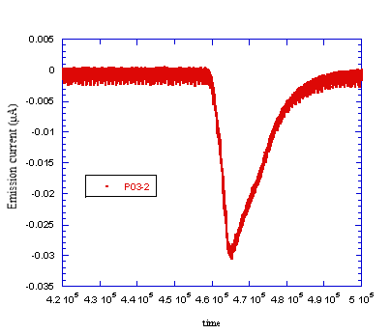
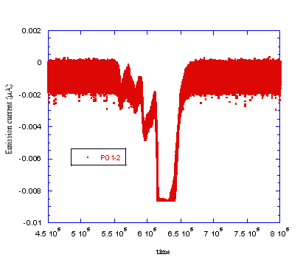
Enhancement of field emission on a grain boundary
1μm
50μm

Slide 31
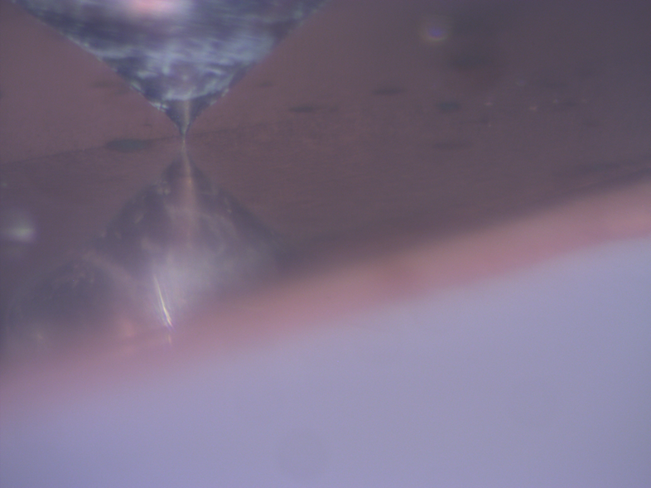
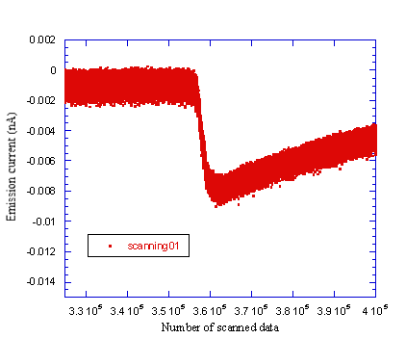
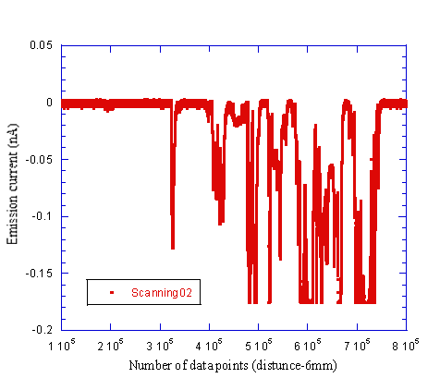
Enhancement of field emission on another grain boundary and on contaminated surface
Detail of boundary
Grain boundary
Scanning direction
Contaminated surface
Conditions
Bias: 450V
Gap: 2mm

Slide 32
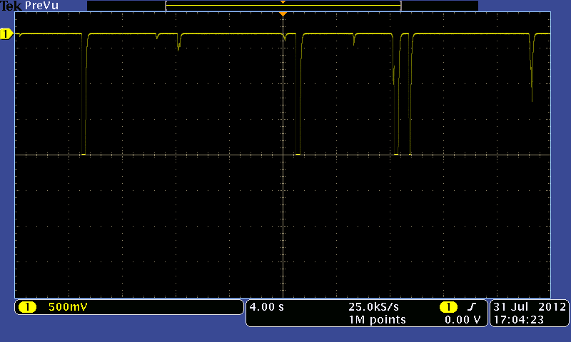
Typical Field Emission distribution on surface of standard, OFHC Class1 copper
Conditions
Bias: 450V
Gap: 2mm
10 points field enhancement / 3.5mm travel

Slide 33
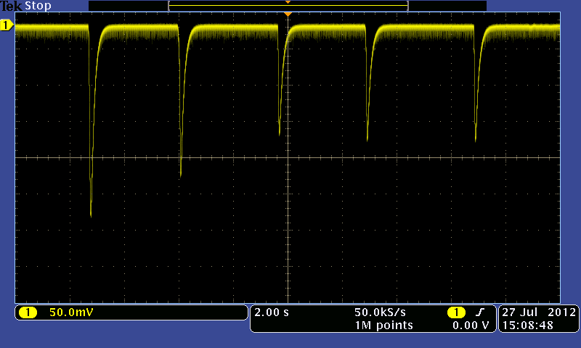
Reproducibility check
Back-and-forth scan of one point of enhanced field emission
Low speed scanning
High speed scanning

Slide 34
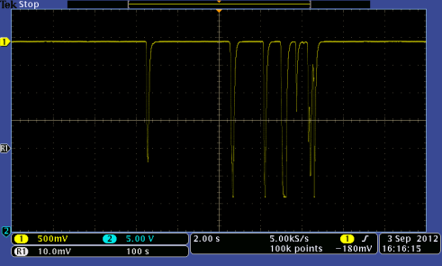
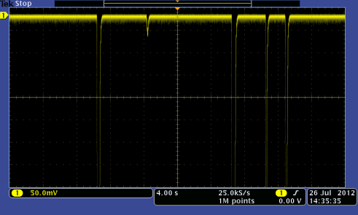
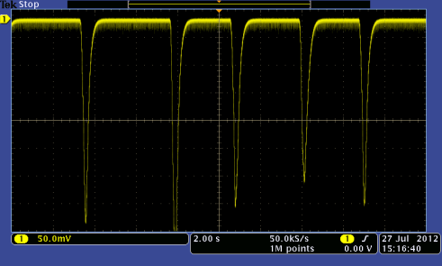

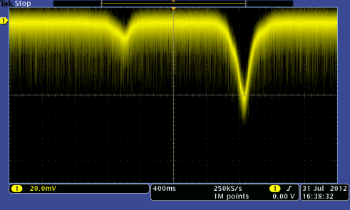

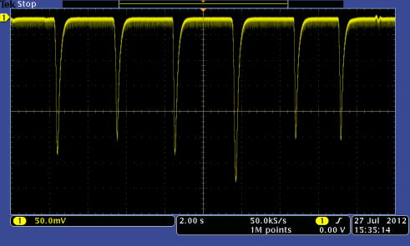
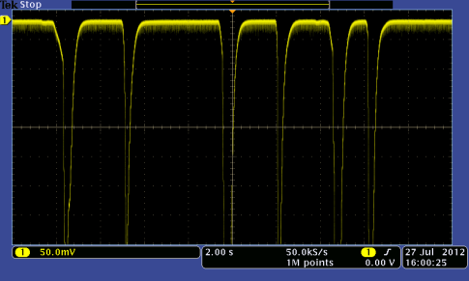


Getting statistics on the field enhancement:
1D scans 12 random locations

Slide 35

Comparison of currents from enhanced and “base” field emission
Location of Enhanced
Field Emission

Slide 36
P3, P3’ P2 P4,P4’,P4” p1
< 10μm
< 3μm

Slide 37
Summary
We observed enhancement of field emission on a grain boundary of the ultra-pure 7N-LG copper
We were able to reproducibly measure enhancement points on surface of standard copper
37

Slide 38
Future Work
Perfect crystal
strength
Target
(minimum dislocation density ~ 10E3/cm^2)
σ th
Actual ACC structure material
Number of dislocations and microscopic defects

